Slide 1




Bioinformatics for Pathway Enrichment Analysis
Part 2
Veronique Voisin and Ruth Isserlin
Computer Ontario Summer school 2025
Compute Ontario-summer school 2025 Bioinformatics.ca

Slide 2
Course outline
General concept of pathway enrichment analysis with a ranked list.
How do we perform pathway enrichment analysis (steps)?
Example :TCGA pancreatic cancer RNASeq expression
Practical lab: pathway enrichment analysis using R and Cytoscape
Compute Ontario-summer school 2025 Bioinformatics.ca
Notes:
Let’s start with the course outline.
During the first few lectures, you have seen how to generate raw proteomics data from mass spectrometry data and today we are learning how to analyze and interpret them using bioinformatic tools.
The presentation has several parts.
First we are going to start with general concept on how to analyze the proteomics data
and then we are going to focus on pathway enrichment analysis which is the focus of today’s lecture.
I have chosen pathway enrichment analysis for today because it is applicable to all omics data and then applicable to different types of proteomics data that you can have.
You will see that it eases a lot the interpretation of the results.
We are going to see that there is a general workflow of pathway enrichment analysis and different steps and we are going to touch a little bit the statistics linked to the method .
And then I will show 2 examples of real life projects that I have worked with; on with bulk proteomics and the other one with single cell proteomics and we will there review again the steps and general workflow of pathway enrichment analysis for these 2 examples
You will see that the output of these analyses is a network, a network of proteins or a network of pathways enriched in your list of proteins and we use a software called Cytoscape to create these network . It is open source, very user friendly and you can download it and try it after the workshop if you would like.

Slide 3
Learning Objectives
Be able to understand:
Be able to run GSEA(Gene Set Enrichment Analysis) on a ranked gene list and understand the main parameters and output results.
Understand the different ways we can visualize enrichment results
the advantages of these different pathway enrichment analysis and visualizations.
Compute Ontario-summer school 2025 Bioinformatics.ca

Slide 4
General Workflow of pathway enrichment analysis
Step1
Step2
Step3
Compute Ontario-summer school 2025 Bioinformatics.ca

Slide 5
General Workflow of pathway enrichment analysis
ENTIRE
RANKED
LIST
Step1
ENTIRE
RANKED
LIST
Step2
Step3
Compute Ontario-summer school 2025 Bioinformatics.ca

Slide 6
Two types of gene lists : defined or ranked list.
omics
data
Defined list
of proteins
Ranked list of proteins
Step 0
Fisher’s Exact Test, aka Hypergeometric Test
GSEA for ranked lists.
Multiple test corrections:
Bonferroni correction
False Discovery Rate computation using Benjamini-Hochberg procedure
Step 1
pathway enrichment test
GSEA
modified Kolmogorov-
Smirnov (KS) test
Fisher’s exact
test
pvalue
pvalue
Step 2
correction for multiple hypothesis testing
corrected pvalue
corrected pvalue
Compute Ontario-summer school 2025 Bioinformatics.ca
Notes:
As already discussed there are two main paths when we are talkng about enrichment analysis, thresholded analysis which consists of a finite list of targets defined by some sort of threshold (for example all hits with adjusted p-value < 0.05 or p_value < 0.01) and non-thresholded analysis consisting of the entire set of differentially expressed genes/proteins.

Slide 7
Why test enrichment with ranked gene lists?
Possible problems with thresholded gene list test include:
No “natural” value for the threshold. Avoids arbitrary cut-offs.
Different results at different threshold settings
Useful for Noisy or Weak Signals
Particularly valuable when no genes are strongly differentially expressed, but pathways still show directional change.
Possible loss of statistical power due to the thresholding
No resolution between significant signals with different strengths
Weak signals are ignored.
** reduces bias, increases reproducibility, and improves sensitivity for detecting real biological patterns
Compute Ontario-summer school 2025 Bioinformatics.ca

Slide 8

Gene Set Enrichment Analysis - GSEA
Original paper published in Nature Genetics 2003 (Mootha el al) and modified and republished in PNAS 2005 (Subramanian et al)
In the original paper, Mootha et al (2003) studied diabetes and identified that their gene list was significantly enriched in a pathway called “oxidative phosphorylation”.
The particularity of this finding was that the individual genes in this pathway were only down-regulated by a small amount but the addition of all these subtle signals had a great impact on the pathway.
They validated their finding experimentally.
Compute Ontario-summer school 2025 Bioinformatics.ca
Notes:
When we talk about GSEA what do we mean?
The name is associate with a publication from 2003 but has now become synonymous with any analysis that uses an entire ranked gene list.
GSEA was originally released as a java desktop application and it is still released and maintained in this format. Although it can be accessed from the command line in its present form it is not the easiest for people to integrate into their pipelines, especially pipelines in R. Mostly it is its reliance on java that makes things complicated.
The original codebase and program has a lot of features and shouldn’t be dismissed.

Slide 9
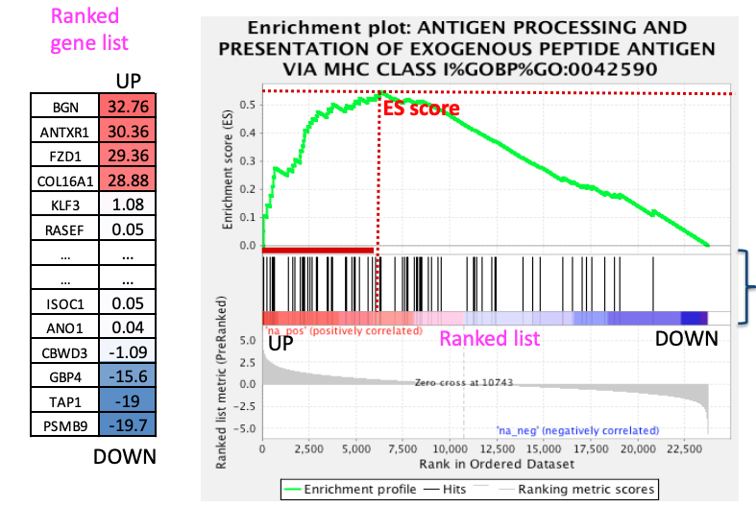
GSEA score calculation
modified Kolmogorov Smirnov test (KS test)
1. Walk down the ranked list of all genes.
2. Increase a running-sum when a gene is in the gene set.
3. Decrease the running-sum when a gene is not.
4. The maximum deviation from zero of this running-sum is the enrichment score (ES)
5. Any gene contributing the ES before the maximum deviation is considered part of the leading edge.
Compute Ontario-summer school 2025 Bioinformatics.ca

Slide 10
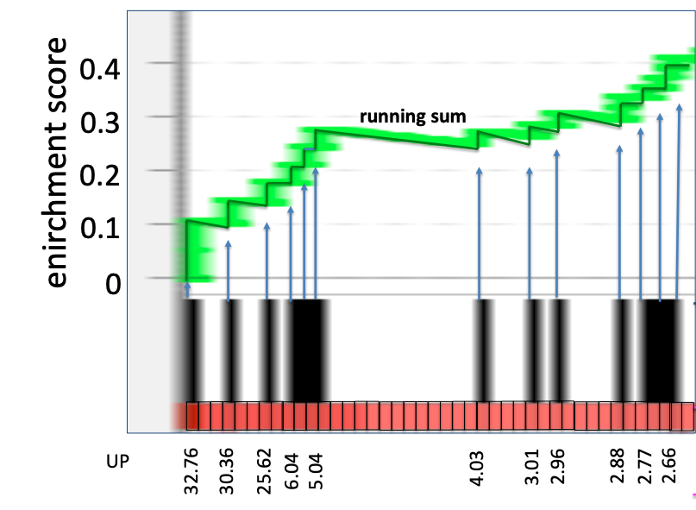
Weighted - Kolmogorov Smirnov test (KS test)
Weight
p=1 (default)
Options:
p=0 no weighting (all genes contribute equally, like Kolmogorov–Smirnov test)
p=1 linear weighting (default)
p>1 more emphasis on top-ranked genes
Found/not found in gene-set (pathway)
Ranks
Compute Ontario-summer school 2025 Bioinformatics.ca
Notes:
Weighted or modified as they call it.
If weighting is equal to zero then the sum increased by 1 for every gene that is found in the set. Irrespective of where in the list gene falls. So what could happen is you can have a pathway with 20 genes, none of them differential that are found in the middle of the list and found in a given pathway it will come back with a high ES score even though none of the genes are differential.
Default value is weight of 1 where the running sum is increased by the rank to power of 1 which end up being the value of the rank.
The decrease in the running sum is a set small value.

Slide 11
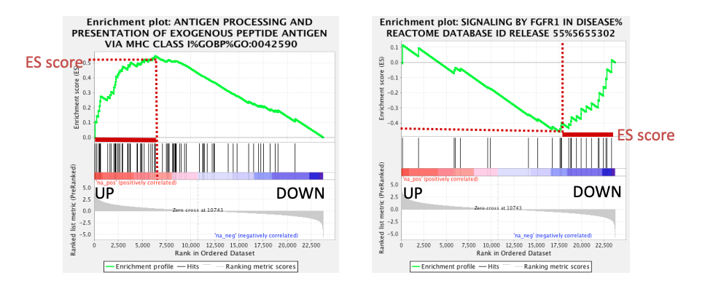
Positive and Negative enrichment scores
Compute Ontario-summer school 2025 Bioinformatics.ca
Notes:
Negative and positive enrichemtn scores are calculated by walking up or down the ranked list.
It is important to mention that sometimes because the way statistical test was done it is not always required that you look at both the positive and negative results. For example when you are using a multiple class design and choose to compare one class to the remaining classes so the positive ranks are specific to the class of interest and negative ranks are specific to the remaining classes and not an individual class. This often comes up with single cell RNASeq analysis.

Slide 12
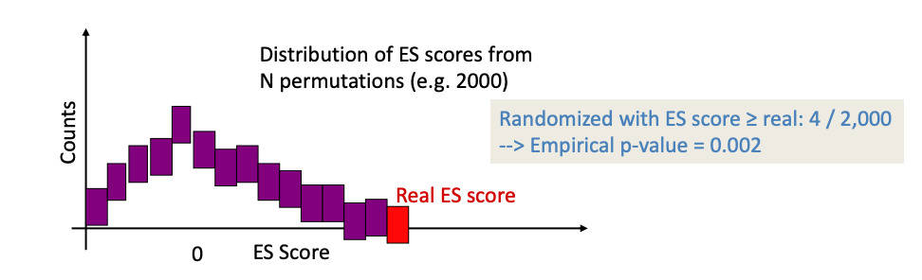
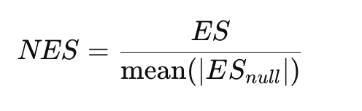
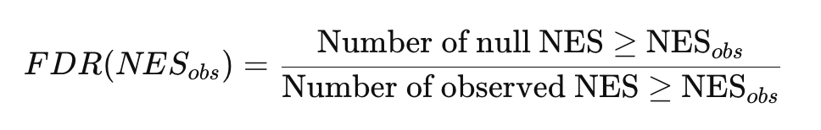
Going from ES, NES, p-value and FDR
Randomize the ranked list and compute ES values for each pathway
Repeat n times (by default 1000, but consider using higher)
P-value = empirical p-value → (number of randomized ES scores > real value) / num of permutations
NES = Normalized ES →
FDR = false discovery Rate is a multiple testing correction that estimates how likely it is that a gene set with a given NES is a false positive.
Compute Ontario-summer school 2025 Bioinformatics.ca
Notes:
The raw ES is normalized by dividing it by the mean of the absolute ES values from the null distribution for that same gene set:
This accounts for the fact that larger gene sets are more likely to get high ES values just by chance.
Raw ES values are not comparable between gene sets of different sizes or distributions.
NES allows fair comparison across sets by adjusting for size and background variability.
The FDR is not simply a corrected p-value or an adjusted p-value, it is calculated using the permuted data and background distribution of NES values.

Slide 13
Which files do we need to run GSEA?
A ranked list of genes called the rank file
this is a text file (tab separated) that should be renamed to end with the extension .rnk
This file has 2 columns :
gene identifier
ranking values
A file called a .gmt file that contains the pathway data base (the gene-sets)
this is a text file (tab separated) that should end with the extension .gmt
the first column contains gene-set names and the additional columns contains the gene names included in each gene-set
Compute Ontario-summer school 2025 Bioinformatics.ca

Slide 14
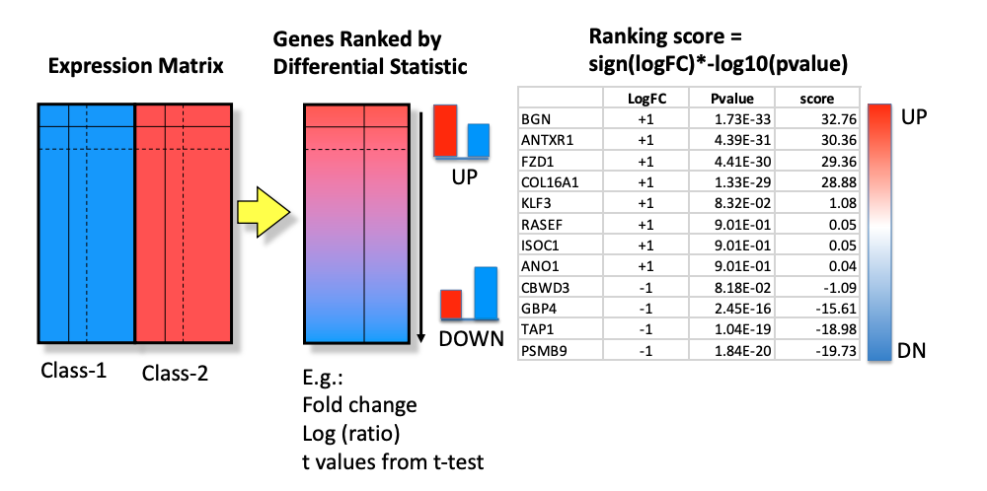
What is a ranked gene list?
Two-class design: ranked gene list
Compute Ontario-summer school 2025 Bioinformatics.ca
Notes:
Not limited to a two class design. Ultimately it could be any comparison but just important to understand what your statistical test is comparing and is describing.

Slide 15
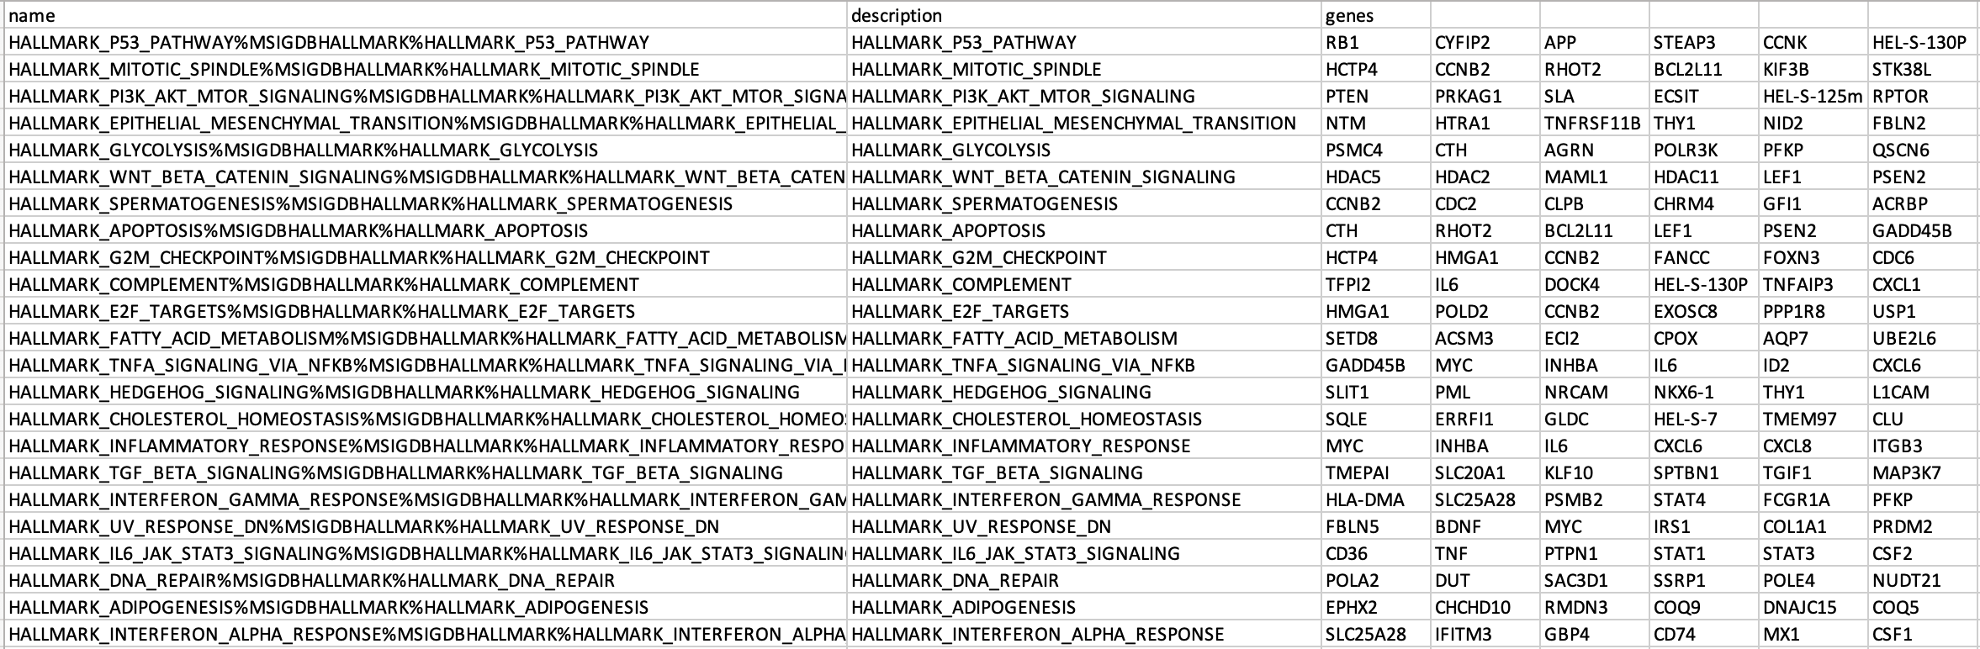
What does a .gmt file look like?
Already introduced in part 1 but just for a refresher
It is a tab delimited text file with extension .gmt that contains pathways and their associated genes
Compute Ontario-summer school 2025 Bioinformatics.ca

Slide 16
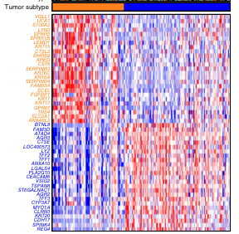
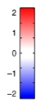
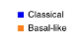
EXAMPLE WITH A RANKED GENE LIST
Dataset
Pancreatic
Ductal
Adenocarcinoma
(TCGA)
Basal
vs
Classical
Differential expression
(edgeR)
Rank file
Gene-Set Enrichment Analysis
(fGSEA)
Moffitt, R., Marayati, R., Flate, E. et al. Virtual microdissection identifies distinct tumor- and
stroma-specific subtypes of pancreatic ductal adenocarcinoma. Nat Genet 47, 1168–1178 (2015)
Compute Ontario-summer school 2025 Bioinformatics.ca

Slide 17
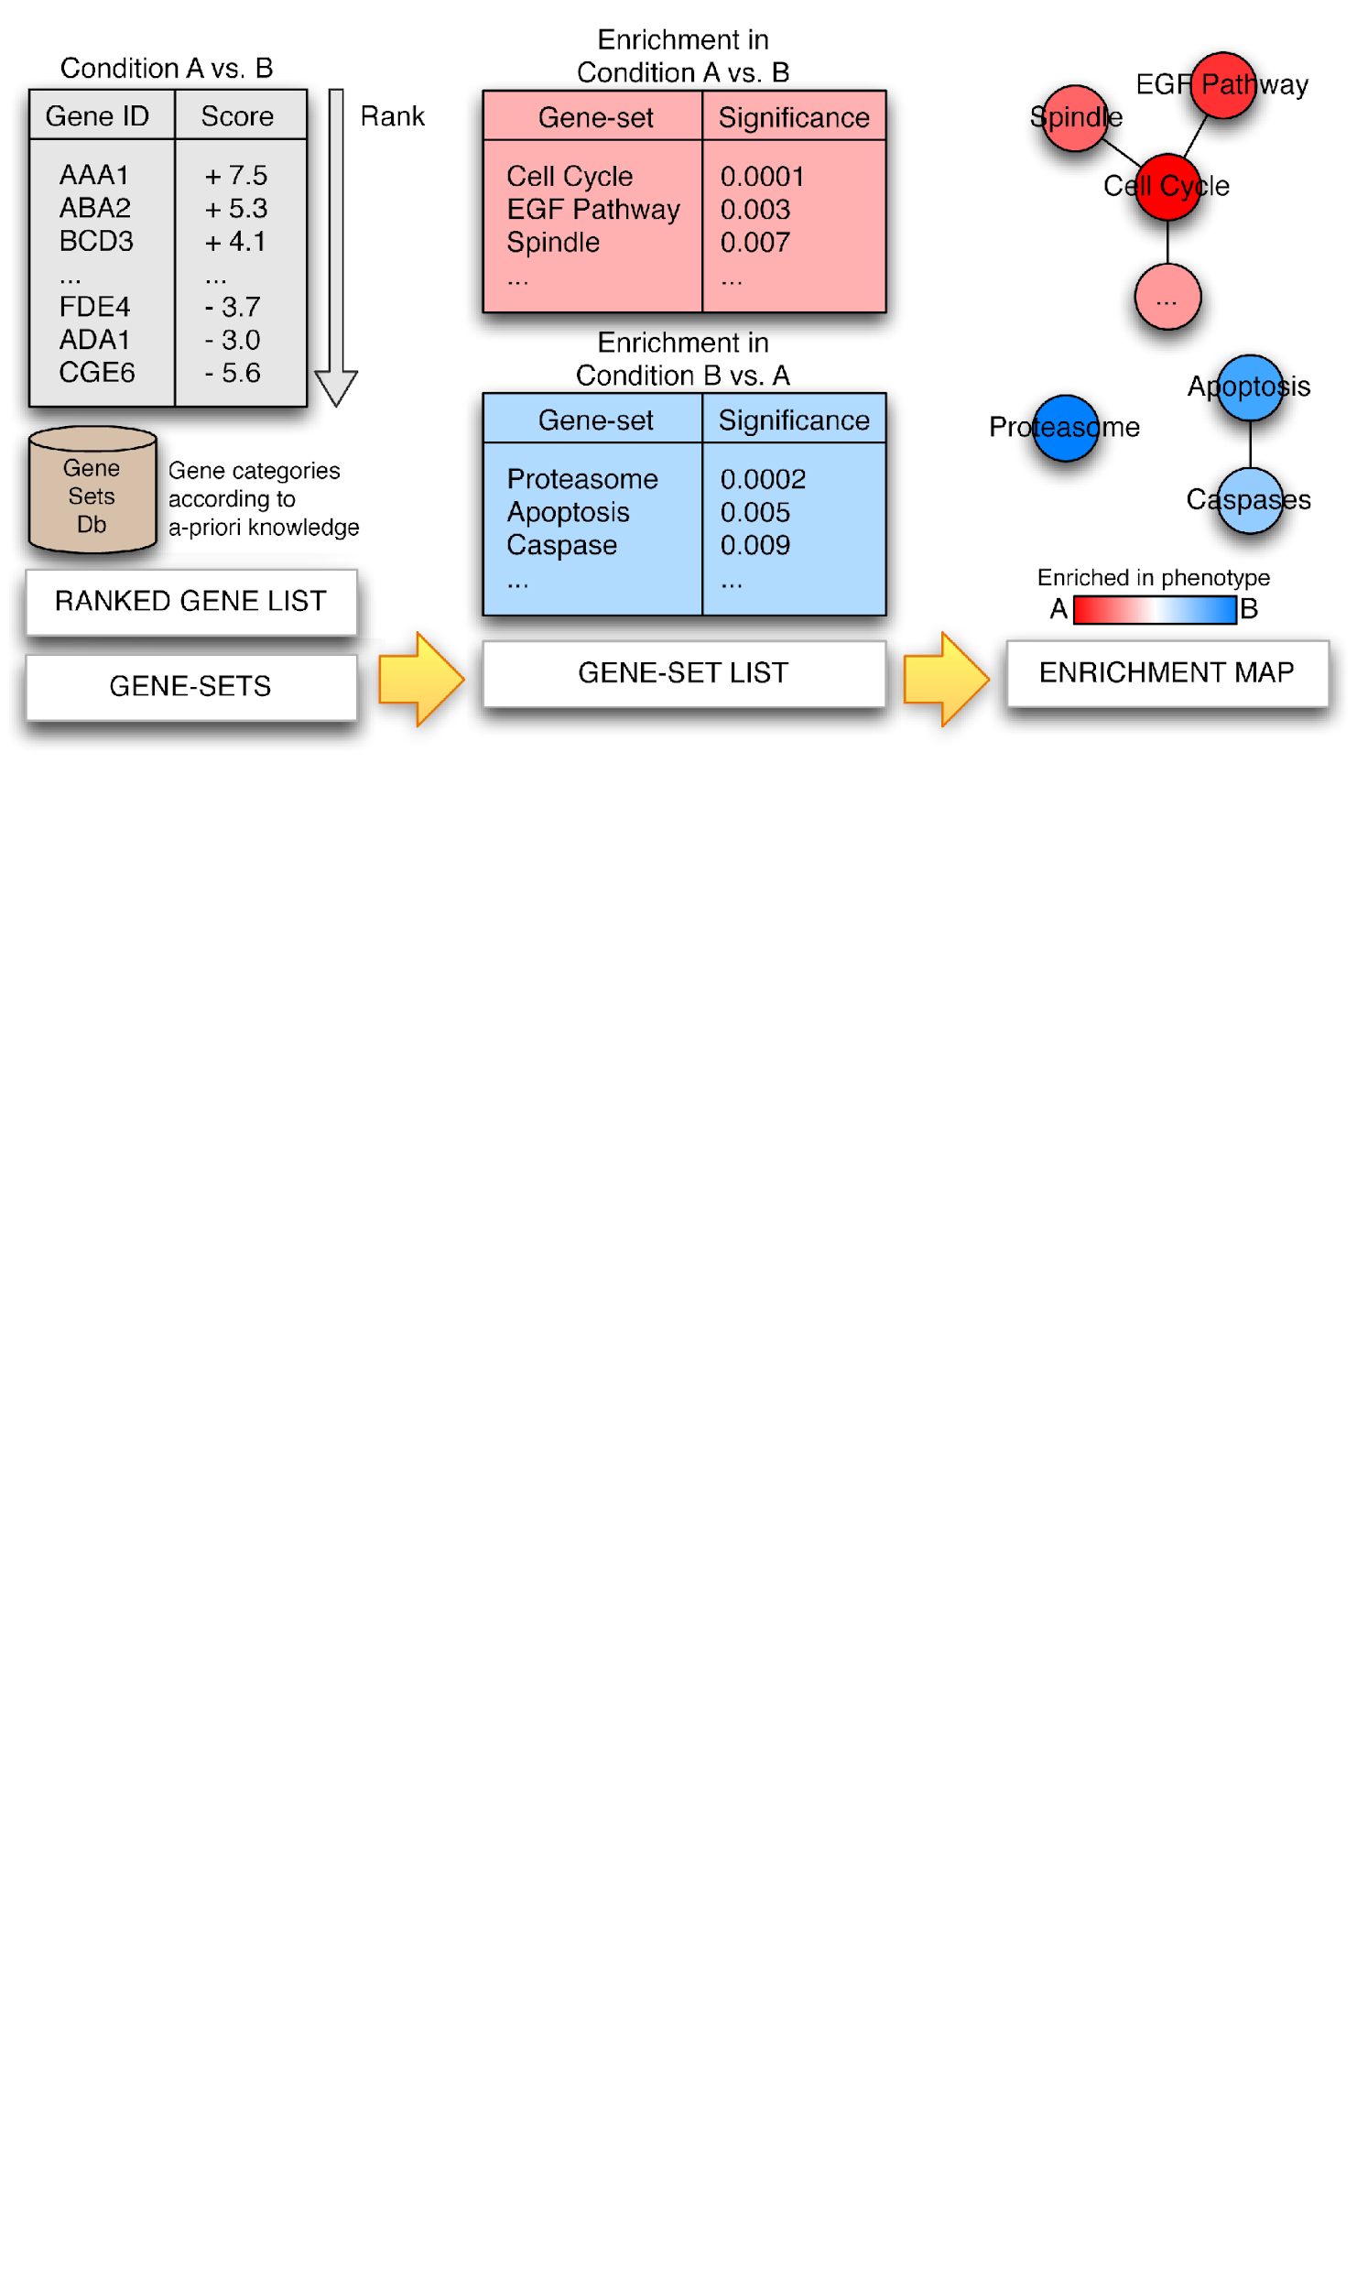
Pathway Enrichment Analysis
Ranked Gene List
GSEA
A
B
UP
(A > B)
DOWN
(B > A)
Pathways
Thresholded lists (selected genes)
g:Profiler
Merico D, Isserlin R, Stueker O, Emili A, Bader GD Enrichment map: a network-based method for gene-set enrichment visualization and interpretation PLoS One. 2010 Nov 15;5(11):e13984
Compute Ontario-summer school 2025 Bioinformatics.ca

Slide 18
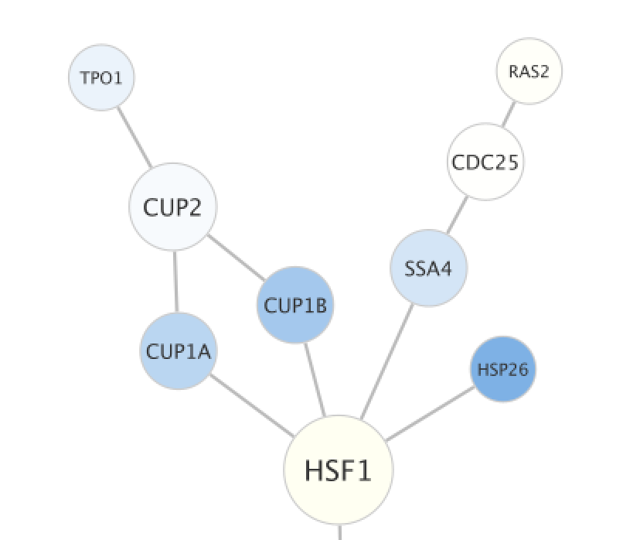
Network Basics
Node (molecule/entity)
Gene
Protein
Transcript
Drug
MicroRNA
…
Edge (interaction/relationship)
Genetic interaction
Physical protein interaction
Co-expression
Metabolic reaction
DNA-binding
…
Compute Ontario-summer school 2025 Bioinformatics.ca

Slide 19
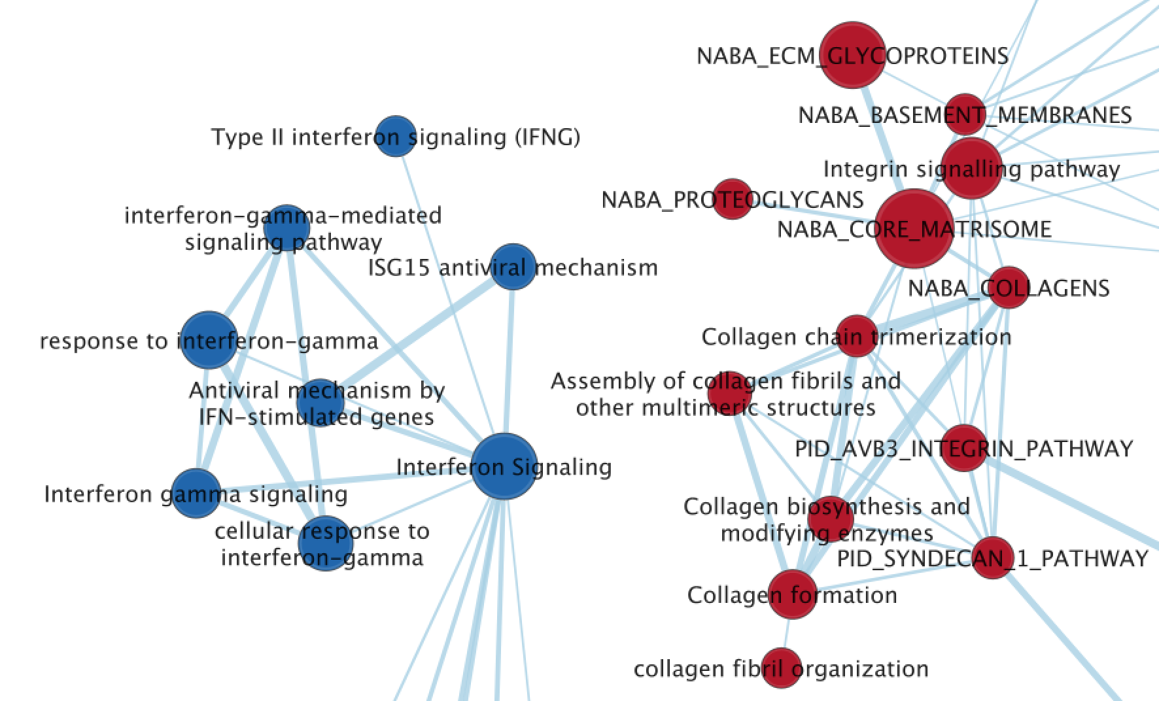
Enrichment Map Basics
Node (molecule/entity)
Pathway or geneset
Size is correlated to number of genes in set
Color indicates class in below example (for example Up/Down, classA/classB)
Edge (interaction/relationship)
Degree of overlap between two genesets
The more genes two pathways have in common the thicker/stronger the connection
Compute Ontario-summer school 2025 Bioinformatics.ca

Slide 20
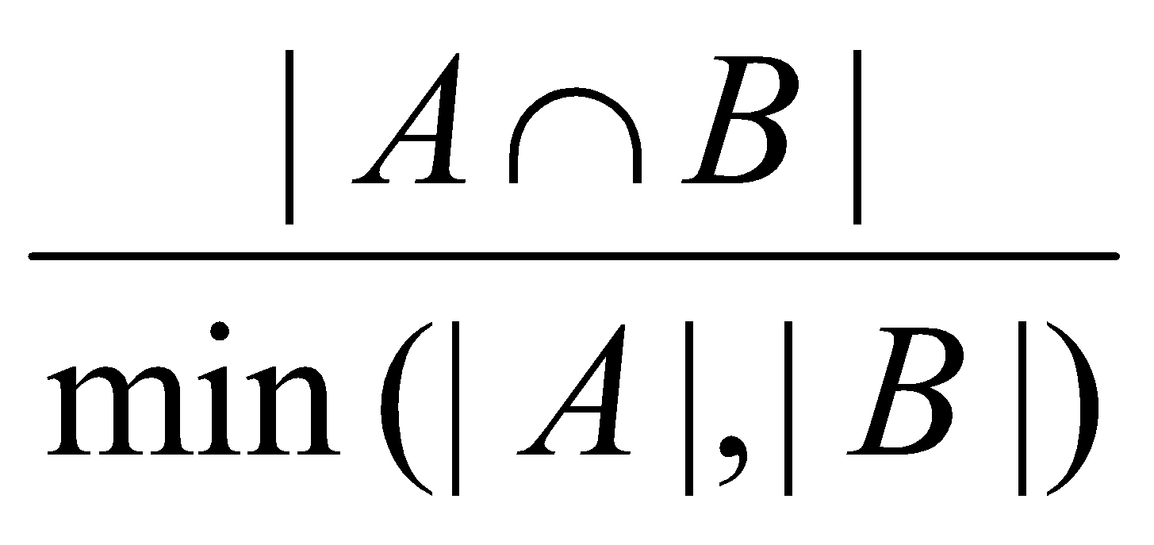
Enrichment Map
Overlap
Compute Ontario-summer school 2025 Bioinformatics.ca

Slide 21
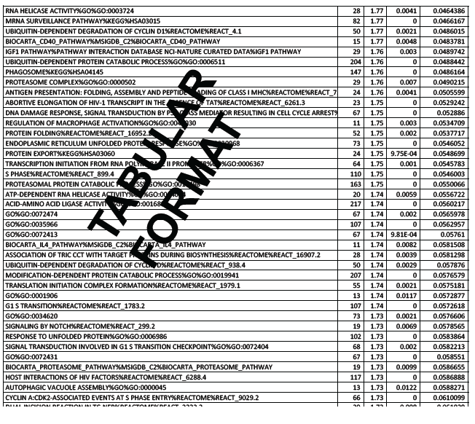
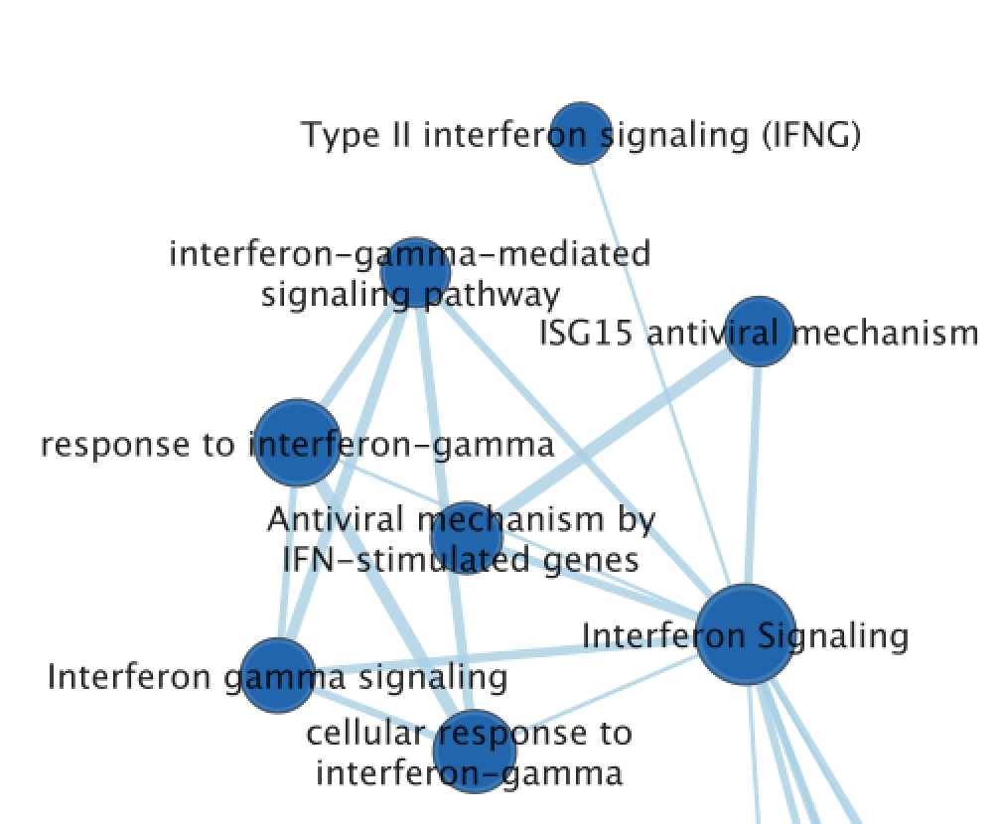
Typical Output
Network Visualization
Each row is a gene-set (pathway).
It displays:
a score associated with the magnitude of overlap between gene-set and gene list.
a pvalue that estimates the significance of the enrichment (by chance or not).
a corrected pvalue (FDR) that corrects for multiple hypothesis testing.
Compute Ontario-summer school 2025 Bioinformatics.ca

Slide 22
During the practical lab:
We will run fGSEA from R
Examine and Visualize the results in R
Create output files that we can then use in Cytoscape
Compute Ontario-summer school 2025 Bioinformatics.ca

Slide 23
This module is taken from
CBW Pathway and Network Analysis Workshop 2024
Compute Ontario-summer school 2025 Bioinformatics.ca
Notes:
We are affiliated with Bioinformatics.ca

Slide 24
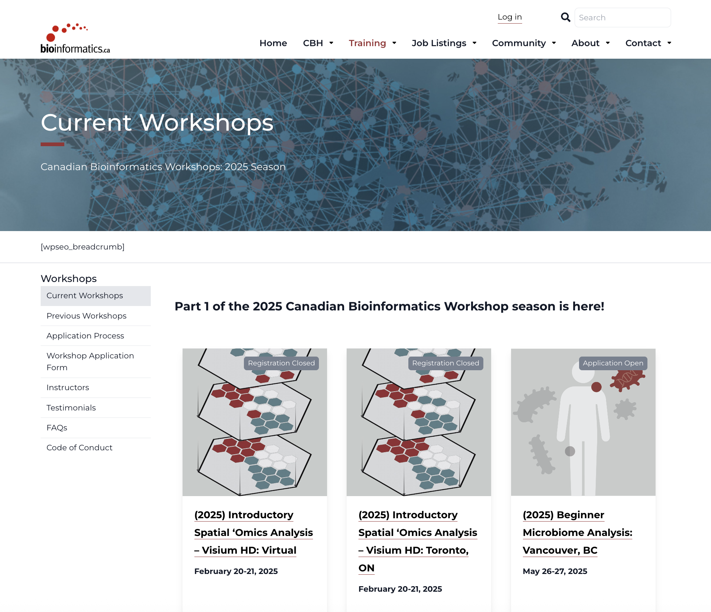
2025 Canadian Bioinformatics Workshop
Please visit the website to see workshops presently offered
https://bioinformatics.ca/workshops/current-workshops/

Slide 25
Time for practical lab
LINK TO GITHUB
Compute Ontario-summer school 2025 Bioinformatics.ca

